Slide 1
Playing Atari with Deep Reinforcement Learning
Control of Robotic Systems / ENPM 667

Slide 2
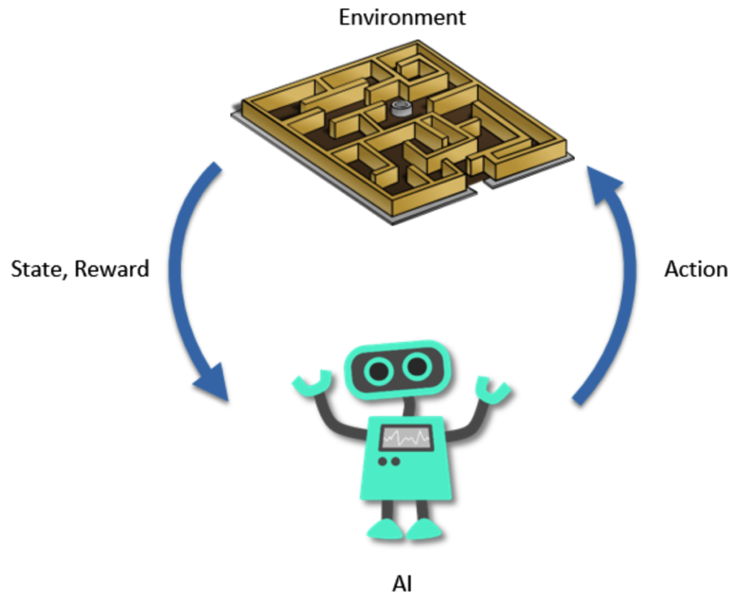
What is Reinforcement Learning ?
Fig.1: System Definition

Slide 3
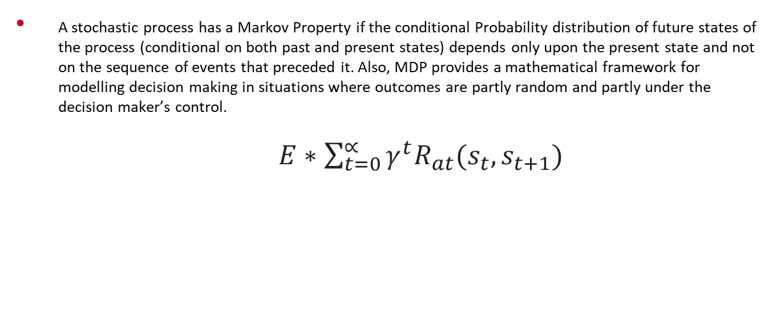
Markov Decision Process
A stochastic process has a Markov Property if the conditional Probability distribution of future states of the process (conditional on both past and present states) depends only upon the present state and not on the sequence of events that preceded it. Also, MDP provides a mathematical framework for modelling decision making in situations where outcomes are partly random and partly under the decision maker’s control.
$E∗\sum_{t=0}^{∝}{γ^{t}R_{at}(s_{t}, s_{t+1})}$

Slide 4


Bellman Equation
Optimal State Value Function:
Optimal State-Action Value Function:

Slide 5
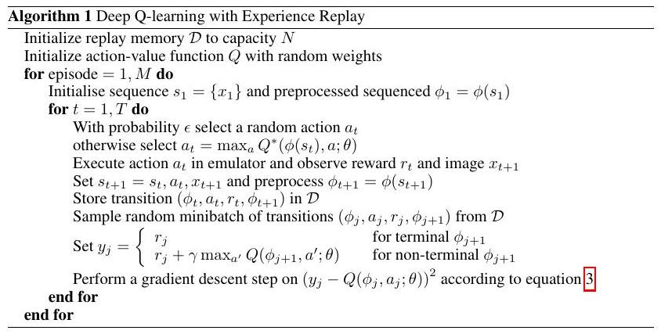
Deep Reinforcement Learning
Fig.2: Training procedure for DQN

Slide 6
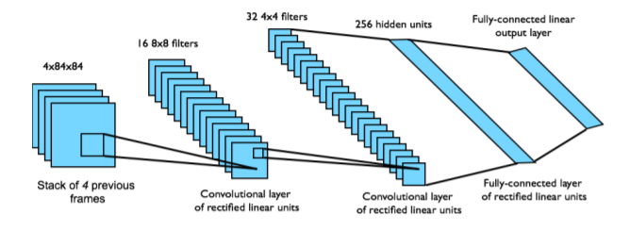
Convolutional Neural Network
Fig.3: Network Architecture

Slide 7
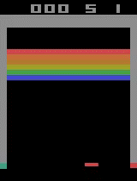
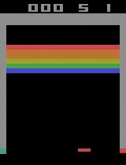
Simulation
Fig.4: Before Training
Fig.5: After Training

Slide 8
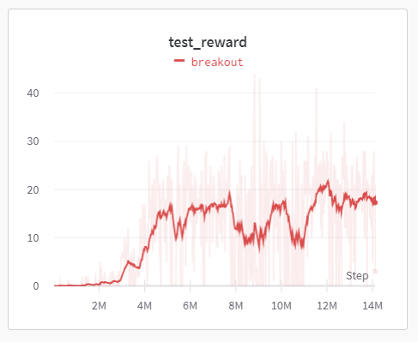
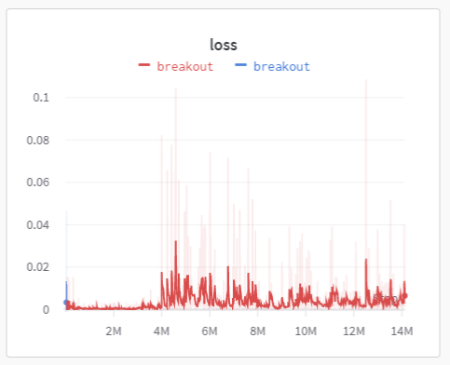
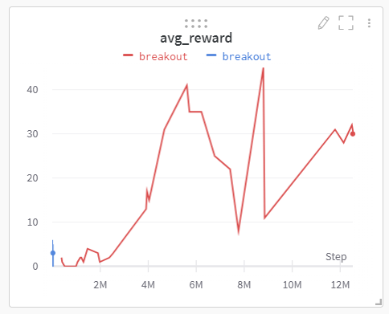
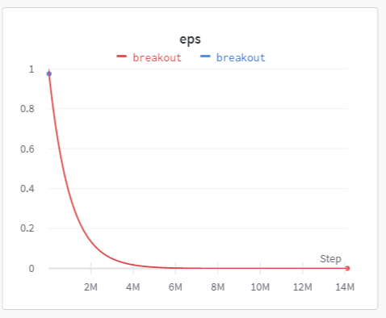
Results
Fig.6: test_reward
Fig.7: loss
Fig.8: avg_reward
Fig.9: epsilon

Slide 9
References
[1] Open AI gym Environment Documentation [link]
[2] PyTorch API Tutorials [link]
[3] ImageNet Classification with Deep Convolutional Neural Networks – Alex Krizhevsky, Geoff Hinton [link]
[4] Reinforcement Learning: An Introduction – Richard S. Sutton and Andrew G. Barto [link]
[5] An Introduction to Markov Decision Processes – Bob Givan and Ron Parr [link]
[6] Deep Reinforcement Learning – David Silver – Google Deepmind [link]
[7] Residual algorithms: Reinforcement learning with function approximation [link]
[8] A neuro-evolution approach to general Atari game playing [link]
[9] Actor-critic reinforcement learning with energy-based policies [link]
[10] Deep Reinforcement Learning in Action – GitHub Repository [link]
[11] Bayesian Learning of recursively factored environments – Marc Bellamare, Joel Veness, [link]
[12] Machine Learning for Aerial Image Labeling - Volodymyr Mnih’s thesis [link]

Slide 10
Paras Savnani
psavnani@umd.edu

